Slide 1

Clinical Resources, Week 4: Scoring the remainder of response types on the PNT
Marianne Casilio, MS, CCC/SLP
Gerasimos Fergadiotis, PhD, CCC/SLP
Notes:
Hi everyone, and thank you again for your participation in this study. Today I’m going to present our fourth and final clinical resource, which is titled “Scoring the remainder of response types on the PNT.” Again, my name is Marianne Casilio and I am working with Gerasimos Fergadiotis in the Aging and Adult Language Disorders lab at Portland State University.

Slide 2
Presentation Outline
Overview of the remainder of the PNT scoring protocol
Scoring correct responses
Scoring miscellaneous responses
Scoring everything else
Clinical assessment applications
Notes:
For today’s presentation, which will be approximately 30 minutes long, I’ll start by providing a brief overview of the remainder of the PNT scoring protocol. Then I’ll discuss how how to score correct, miscellaneous, and other types of responses in-depth. We’ll then close by reviewing a few assessment applications that tie together concepts covered across the four weeks of clinical resources.

Slide 3
Overview of the remainder of the PNT scoring protocol
Notes:
Let’s begin by providing an overview of the remaining scoring procedures for the PNT and discuss how they fit into the paraphasia error coding system we reviewed in the training presentation.

Slide 4
PNT Coding Flowchart
Is the response correct?
Correct (C)
YES
No Response (NR)
Is the response one or more nonword phrases?
NO
NO
Is the response a phrase or a single verb, adjective, or adverb?
NO
Code as miscellaneous
Is the response a noun?
YES
NO
Description (D)
YES
Does the response share only a phonological relationship with the target?
NO
YES
Code as miscellaneous
Formal (F) *
NO
YES
Is the response a paraphasia?
Code as paraphasia
* Reminder: Formal (F) is a type of paraphasia.
YES
Notes:
The PNT scoring procedure overall can be conceptualized using the following flowchart. If we review the various pathways, we’ll see that paraphasias constitute a small yet important part of the overall scoring scheme. Specifically, we can see that coding a paraphasia requires that the person produces an incorrect response that is a noun and fits within the three linguistic dimensions that constitute a paraphasia – lexicality, semantic similarity, and phonological similarity. Given the complexity of coding paraphasias, we have a separate flowchart for these types of responses specifically, which was reviewed during the training presentation. One important note, however, is the presence of one specific paraphasia in the traditional taxonomy you’ve been using so far in this study, which is Formal or F. This is to highlight a specific case in which a formal is coded in the larger coding scheme and was not covered explicitly in the training presentation. We will review this in depth in the following slides.
Other possible responses, as you can see in the flowchart, are correct responses, no response or NR responses, description or D responses, and miscellaneous responses. As with paraphasias, miscellaneous responses constitute several different types and require additional considerations beyond those covered in this specific flowchart. As such, we have provided a flowchart for these types of responses specifically, which we will review in just a moment. It is important to note, however, that miscellaneous-type responses occur far less frequently than say, paraphasias or correct responses.
Finally, it is important to note that this coding scheme is what the PNT developers called “conventional coding”. They have developed additional schemes; however, given that this scheme is what is abbreviated for use in the development of Dell’s model of spoken language production and is covered in the greatest depth in their training materials, it is the one we’ve chosen to review with you today.

Slide 5
Paraphasia Coding Flowchart
Semantic (S)
Is the response semantically similar to the target?
YES
Is the response phonologically similar to the target?
Is the response a real word?
YES
Other (O)
NO
NO
Abstruse Neologism (AN)
NO
YES
Is the response a real word?
Neologism (N)
NO
Formal (F)
Is the response a proper noun?
NO
YES
Is the response semantically similar to the target?
NO
Neologism (N)
Is the response an added morpheme to a noun or a subbed/added morpheme to a compound?
NO
YES
Mixed (M)
YES
Semantic (S)
YES
Notes:
As mentioned just a moment ago, the paraphasia coding flowchart, which you’ve been using over the last four weeks, can be seen as one component of the overall scoring procedure. It’s been included here as a reference but otherwise will not be the focus of today’s presentation.

Slide 6
Miscellaneous Coding Flowchart
Is the response a proper noun with no semantic or phonological relationship to the target?
Is the response a part of the picture?
Is the response a real word?
Is a morpheme omitted from the response?
* plural morpheme not considered *
NO
NO
YES
YES
YES
NO
YES
Morpheme Omission (MO)
Proper Noun (PN)
Picture Part Error (PPE) *
Is the response one or more meaningless phrases?
Phonological Jargon (PJ)
YES
NO
Is the response a blend of two words that are semantically and phonologically similar to the target?
Blend (B) *
YES
* Note: Blend (B) responses can, on occasion, be real words as well. Similarly, Picture Part Error (PPE) can be a nonword per the scoring rules but, in our experience, we have not seen this occur.
Notes:
The final flowchart to share is one that breaks down the different types of miscellaneous responses. As you can see with the note in the lower right corner of the slide, there are a few caveats to organizing the various codes in the manner they have, which we will discuss further in a few minutes.

Slide 7
Before scoring…
Identify the first complete attempt
Find the first minimally CV (consonant-vowel) or VC (vowel-consonant) response. Of note, schwa does not count as a vowel here.
Ensure that the minimally CV or VC response is not self-interrupted.
Make a note of intonation: downward or upward intonation = take the first minimally CV or VC response; even tone = wait one second for a subsequent response; if there is one, take this as the first complete attempt.
Keep in mind there are special rules for targets that are three or more syllables: a monosyllabic responses are not considered first complete attempts unless they are (a) semantically similar or (b) contain one of the target’s morphemes.
Transcribe the first complete attempt
Choose whether orthography or IPA is appropriate: real words = orthography; nonwords = IPA.
If using IPA, broad or narrow transcription can be used.
Follow a commonly understood set of symbol conventions.
Primary stress markings and syllable boundaries are needed to accurately determine phonological similarity.
Notes:
Now that we’ve provided a general framework for the entirety of the PNT scoring protocol, we’ll briefly discuss two important steps that are required prior to the coding process.
The first is identifying what is called the first complete attempt, which helps you determine which response to score, given that individuals with anomia may often make multiple attempts to respond to a given picture. This is defined as the first response that consists of a consonant-vowel or vowel-consonant structure that does not include the vowel schwa. Importantly, this response cannot be considered self-interrupted and is dependent on the type of intonation used. Specifically, if the response is produced with an upward or downward intonation, then it is taken as the first complete attempt. However, if the response is produced with even intonation, it is only considered the first complete attempt if a subsequent attempt is NOT produced in one second following the initial attempt. Finally, there are special considerations when determining the first complete for targets that are three or more syllables. For these targets, a single syllable response is not considered a first complete attempt UNLESS it is semantically similar to the target or contains one of its morphemes. Importantly, responses produced before the first complete attempt, or sometimes those that follow the first complete attempt, that do not meet the following criteria are considered fragments. For further details on fragments, we have provided a link to the original scoring procedure document for the PNT with this presentation, which covers fragments in more depth, and we'll take a look at that link at the end of these slides.
Once the first complete attempt is identified, then the first complete attempt can be transcribed. Here, our recommendations generally follow the PNT scoring procedure but also include adaptations our lab has used in transcribing and coding PNT responses. First, it should be determined whether orthography or IPA is appropriate as a means of improving coding efficiency, given that transcription is a time-consuming task. Here, we recommended that real words are written in orthography and only nonword responses are written in IPA. When using IPA, a broad or narrow transcription can be used; however, our lab has opted to use broad transcription for the sake of efficiency. When transcribing, we recommend following a commonly understood set of symbol conventions and that stress and syllabification are marked to improve the accuracy of identifying phonological similarity for paraphasia responses.

Slide 8
Scoring correct responses
Notes:
Now that we’ve reviewed the types of responses that remain in the PNT scoring protocol, let’s take a look at how correct responses are scored.

Slide 9
PNT Coding Flowchart
Is the response correct?
Correct (C)
YES
No Response (NR)
Is the response one or more nonword phrases?
NO
NO
Is the response a phrase or a single verb, adjective, or adverb?
NO
Code as miscellaneous
Is the response a noun?
YES
NO
Description (D)
YES
Does the response share only a phonological relationship with the target?
NO
YES
Formal (F) *
Code as miscellaneous
YES
Is the response a paraphasia?
NO
Code as paraphasia
* Reminder: Formal (F) is a type of paraphasia.
YES
Notes:
Here is the PNT coding flowchart that we reviewed earlier, where only the pathway to a correct response has been highlighted.

Slide 10
Correct (C)
Response matches the target. The addition or deletion of the plural morpheme is allowed (in other words, ignore the presence or absence of a plural morpheme when determining a response’s accuracy).
Acceptable variations: Acceptable phrases:
“falls” for waterfall “a type of ______”
“mountain top” for mountain prepositional phrases (e.g., “can of peas”)
modifiers (e.g., “dog’s bone”)
Speakers of a non-standard English dialect should not be penalized for dialectal variations in pronunciation (e.g., omission of the final consonant in a word-final consonant cluster).
Notes:
As common sense would dictate, a correct response is one that matches the target. Importantly, in the PNT scoring scheme, the addition or deletion of a plural morpheme is allowed, as are a few variations and phrase-type responses, which are highlighted on the slide. Finally, dialectal variation observed in healthy speakers of non-standard English should not be considered errors; these responses should be scored as correct.

Slide 11
Scoring miscellaneous responses
Notes:
Now let’s move on to review how miscellaneous responses are scored.

Slide 12
PNT Coding Flowchart
Is the response correct?
YES
Correct (C)
No Response (NR)
Is the response one or more nonword phrases?
NO
NO
Is the response a phrase or a single verb, adjective, or adverb?
NO
Code as miscellaneous
Is the response a noun?
YES
NO
YES
Does the response share only a phonological relationship with the target?
NO
Description (D)
YES
Code as miscellaneous
YES
Formal (F) *
Is the response a paraphasia?
NO
Code as paraphasia
* Reminder: Formal (F) is a type of paraphasia.
YES
Notes:
And again, as with correct responses, we can again review the PNT coding flowchart to see how we may arrive at a miscellaneous response. Specifically, miscellaneous responses are generally incorrect responses that are either nouns that are not paraphasias or one or more nonwords.

Slide 13
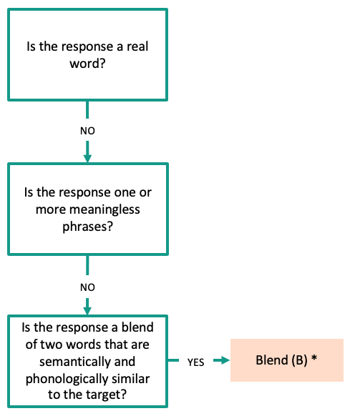
Blend (B)
A word or nonword response that is a blend of two synonyms to the target, or a blend of the target and an identifiable synonym: There must be close semantic association and phonological similarity, such as “banapple” for pineapple.
Notes:
There are five types of miscellaneous responses, the first of which is blends and are coded using the letter B. Blends can be defined as either a word or nonword response that consists of either two synonyms of the target or a blend of the target and an identifiable synonym. Importantly, there must be a close semantic association and phonological similarity for a response to be considered a blend, such as the example on the screen, where the person produced “banapple” for pineapple.
Importantly, while a blend can be either a word or a nonword, you’ll see in the portion of the miscellaneous flowchart included on the screen, we have only listed blends as nonwords. This is because, in our experience, almost all blend responses are nonlexical in nature.

Slide 14
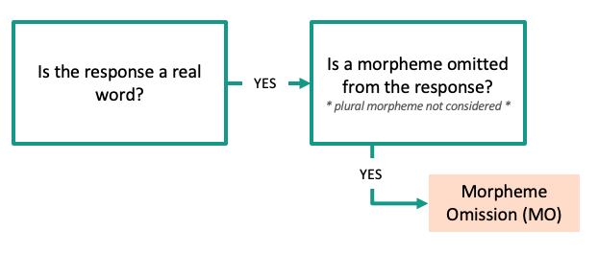
Morpheme Omission (MO)
A response that is a morphological omission in a multimorphemic target, such as “cow” for cowboy.
Notes:
The second type of miscellaneous response is morpheme omission, or MO, where a morpheme has been omitted from a multimorphemic target, such as producing “cow” for cowboy. As with the last miscellaneous response, the pathway for arriving at this type of response has been clipped away from the larger miscellaneous coding flowchart to demonstrate how one might arrive at this type of code.

Slide 15
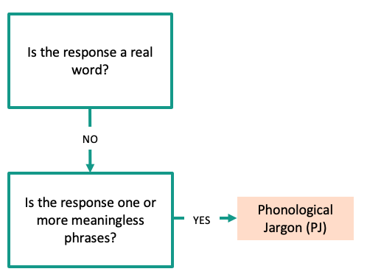
Phonological Jargon (PJ)
A response that consists of one or more meaningless phrases. The response consists either exclusively or predominantly of nonwords, such as “he’s down ɹu'mən æ'zɚ a bɛ'skləf” for dog.
Of note, our lab and the primary dataset used to develop the PNT have not used this code.
Notes:
Our third type of miscellaneous response is phonological jargon, or PJ, which is a response that consists of one or more meaningless phrases. Importantly, while this code is outlined in the original PNT scoring manual, our lab has not used this code for our purposes, nor was this code used in the original dataset used to develop the PNT.
And again, as with the last miscellaneous response, the pathway for arriving at this type of response has been clipped away from the larger miscellaneous coding flowchart to demonstrate how one might arrive at this type of code.

Slide 16
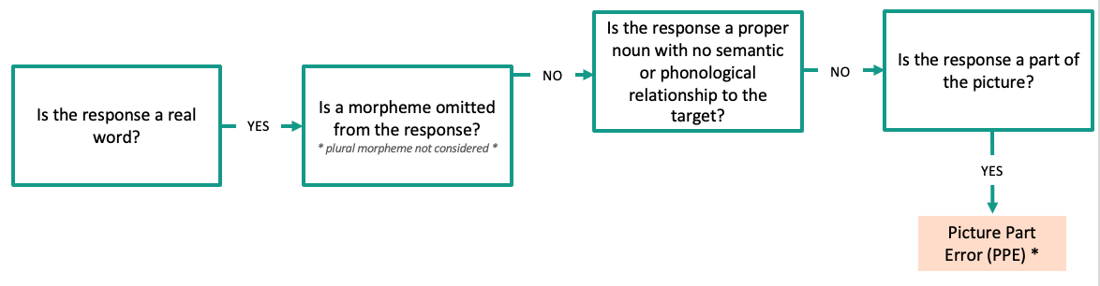
Picture Part Error (PPE)
A response that is a component of the depicted target, such as “veil” for bride. It is not dependent in semantic or phonological similarity.
Notes:
Our fourth type of miscellaneous response is a picture part error, or PPE, which is when the response is a component of the depicted target, such as “veil” for bride. Importantly, this code is not dependent on phonological or semantic similarity, meaning that, if a response meets either of those criteria, its similarity or dissimilarity along these dimensions is ignored and it is automatically coded as a picture part error.
Similar to blends, picture part errors can be real word or nonword responses; however, in our experience with coding, we have only been able to clearly identify picture part errors that are real word responses.
And again, as with the last miscellaneous response, the pathway for arriving at this type of response has been clipped away from the larger miscellaneous coding flowchart to demonstrate how one might arrive at this type of code.

Slide 17
Proper Noun (PN)
A proper noun response that has no semantic or phonological relationship to the target.
Proper noun responses with a semantic and/or phonological relationship to the target should be coded as paraphasias.
Notes:
Finally, our last type of miscellaneous response is proper noun, or PN, which is a proper noun that bears no semantic or phonological relationship to the target. Importantly, as was highlighted in the training presentation, proper noun responses with a semantic and/or phonological relationship to the target should be coded as paraphasias following the paraphasia coding flowchart.
And again, as with the last miscellaneous response, the pathway for arriving at this type of response has been clipped away from the larger miscellaneous coding flowchart to demonstrate how one might arrive at this type of code.

Slide 18
Scoring everything else
Notes:
Now let’s move on to review the remaining types of responses that may be produced on the PNT.

Slide 19
PNT Coding Flowchart
Is the response correct?
Correct (C)
YES
No Response (NR)
Is the response one or more nonword phrases?
NO
NO
Is the response a phrase or a single verb, adjective, or adverb?
NO
Code as miscellaneous
Is the response a noun?
YES
NO
Description (D)
YES
Does the response share only a phonological relationship with the target?
NO
YES
Code as miscellaneous
Formal (F) *
NO
YES
Is the response a paraphasia?
Code as paraphasia
* Reminder: Formal (F) is a type of paraphasia.
YES
Notes:
Here again we have the PNT coding flowchart with only the codes and pathways of interest highlighted. There are two remaining codes – no response and description – which are among the most common types of responses produced on the PNT.

Slide 20
No Response (NR)
A response that indicates verbally or non-verbally that the client cannot name the picture.
This includes:
Fragments (i.e., no first complete attempt) or absence of any verbal output
General commentary (e.g., ”Oh boy, that’s hard”)
Personal commentary (e.g., “I just used one of those yesterday”)
Sound effects (e.g., ”hoot” for owl)
Spelling words aloud (e.g., “W I D E R” for spider)
Whispered responses
Notes:
The first is no response, or NR, and as the name suggests, it is a response that indicates that the person cannot name the picture. One of the most common examples of this type of response is “I don’t know”; however, it can also include instances where no verbal output is provided or only fragments are produced. These types of responses may also include general or personal commentary, sound effects, spelling, or whispered responses.

Slide 21
Description (D)
A response that provides a characterization of the target or attempts to explain its function or purpose (e.g., “an animal with fur and whiskers” for cat).
This also includes:
A single verb, adjective, or adverb that has a semantic relationship to the target
A single verb, adjective, or adverb that has no semantic relationship to the target
A response in the from of “type of X” where “X” is the supraordinate of the target (e.g., “a type of fruit” for apple)
A response that negates the target (e.g., “not a dinosaur” for dinosaur)
A response that has a carrier verb phrase that includes the target (e.g., “open the door” for door)
Notes:
The second is description, or D, which generally fits a more commonly understood behavior in those with anomia, which is circumlocution. This type of response is defined as a characterization of the target or an attempt to explain its purpose. While it is most commonly a phrase similar to the example on the screen, where the person says “an animal with fur and whiskers” for the target cat, description responses can also include single verb, adjective, or adverb responses that may or may not have a semantic relationship to the target. Importantly, single verb, adjective, or adverb responses that have only a phonological relationship to the target should be coded as a formal paraphasia, as was notated on the larger flowchart and mentioned earlier. Other types of description responses may be a phrase that negates the target or a response that contains a carrier verb phrase.

Slide 22
Perseverations
Instances where a response that was previously provided is repeated during the same test administration.
This is a secondary code that is added to a paraphasia.
To add a perseveration code:
Code the response as a paraphasia
If perseverated, add “–P” to the end (e.g., ”S-P”)
Notes:
Finally, it is worth taking a moment to discuss perseverations. While these are not assigned a primary code in the PNT scoring scheme we've reviewed, they can be used as a secondary code that is added to a paraphasia code if desired.

Slide 23
Clinical assessment applications
Notes:
Now that we’ve had a chance to review the remainder of the PNT scoring protocol, we’ll review some ways this information can be applied to clinical assessment by building on information we've covered over the last few weeks.

Slide 24
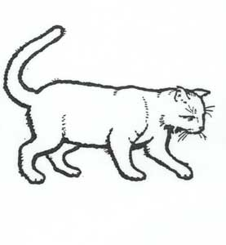
Correct responses reflect adequate access and retrieval of the word and phonemes
SEMANTICS
“Name this picture”
LOG
DOG
CAT
RAT
MAT
WORDS
l
r
d
k
m
æ
o
t
g
PHONEMES
ONSETS
VOWELS
CODAS
Notes:
The types of responses that we’ve reviewed in today’s presentation fit within our larger understanding of the linguistic processes that drive lexical retrieval. Returning to Dell’s model for a moment, we can see that correct responses reflect adequate access and retrieval of words and phonemes. In other words, the system is working as it should.

Slide 25
Non-paraphasia responses generally reflect a failure to retrieve a word form for the presented picture
SEMANTICS
?
“Name this picture”
LOG
DOG
CAT
RAT
MAT
WORDS
l
r
d
k
m
æ
ɔ
t
g
PHONEMES
ONSETS
VOWELS
CODAS
Notes:
However, the opposite is generally true for the remaining responses we reviewed today, which can all be categorized together as non-paraphasia responses, or, as they were referred to in the training presentation – omissions or non-naming responses.
These types of responses reflect a failure to retrieve a word form for the presented picture due to weak activation or poor spread of activation. In anomia associated with post-stroke aphasia, this is typically thought to be a severe failure at the level of step 1, lexical semantic processing. However, failures like these may be due to other processes in other etiologies. For example, non-paraphasia responses are common in individuals with semantic dementia because of focal degradation to brain regions that store and process conceptual knowledge, or semantic memory. In contrast, an individual with anomia due to a traumatic brain injury may produce non-paraphasia responses due to impaired attention or other domain-general cognitive processes.

Slide 26
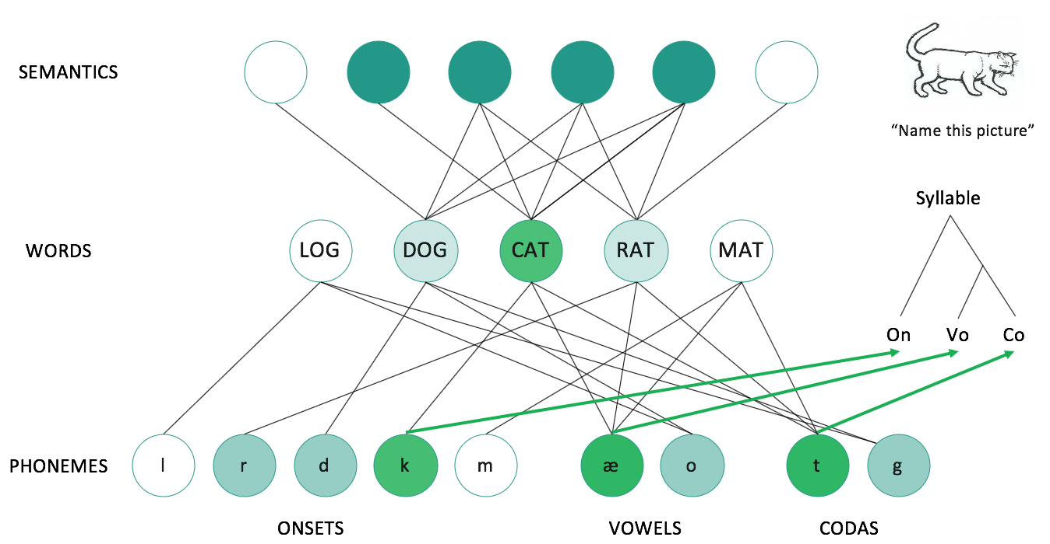
The type and prevalence of different response types provides information about the integrity of the naming system.
Level of Impairment | Response Type
 | Correct | Paraphasia | No Response | Description | Miscellaneous
Failure to select a word form | ✗ | ✗ | ✓ | ✓ | ✓
Mis-selection of the word form (Step 1 breakdown) | ✗ | ✓ | ✗ | ✗ | ✗
Mis-selection of the sound form (Step 2 breakdown) | ✗ | ✓ | ✗ | ✗ | ✗
Notes:
As such, we can use the full scoring protocol to inform our understanding of the naming system at large, as well as potential external influences on the naming system. On the screen, we have an expanded version of the paraphasia chart provided in the week two clinical resource, where each type was broken down by level of impairment. The chart here now includes all response types, as well as an additional level of breakdown that assumedly occurs prior to step 1, which is a failure to select the appropriate word form at all. Again, as with the previous chart, the checkmark is used to indicate the step or stage at which the breakdown occurs. Moving left to right through the columns on the chart, we can see that correct responses expectedly reflect no locus of breakdown, while paraphasias reflect a breakdown at step 1, step 2, or both; no response, description, and miscellaneous responses – all of which can be considered non-paraphasia responses – instead reflect a general failure to select a word form within the naming system.

Slide 27
Using the full scoring protocol in clinical practice
Expand administration of a naming test to include non-paraphasia coding by using the full protocol or, if under more time constraints, tallying the total of correct, lexical paraphasia, nonlexical paraphasias, and non-paraphasia responses
Incorporate a review of psycholinguistic variables to determine if non-paraphasia responses systematically vary along different dimensions (e.g., three syllable words result in non-paraphasia response while two-syllable responses result in nonlexical responses)
Consider the prevalence of non-paraphasia responses and their potential etiology in neurologically complex clients (e.g., bilateral infarcts, superimposed dementia)
Notes:
As we discussed with paraphasia coding and the use of psycholinguistic variables, those recommendations can be expanded upon to include the full scoring protocol. Specifically, one could administer a naming test and include the full range of potential codes. Depending on time constraints, this could range from coding responses using the conventional PNT scoring system outlined here or abbreviated to include only correct, lexical paraphasia, nonlexical paraphasia, and non-paraphasia responses. Then, a review of psycholinguistic variables could be done to better understand whether non-paraphasia responses are the result of difficulty along one or more dimensions. For example, an individual may consistently produce a non-paraphasia response for three syllable words but generally produce nonlexical responses – reflecting some degree of access to the naming system – for two syllable words. This information could then be used to perform more specific testing or develop a treatment program, as outlined last week, or to better inform a clinician’s understanding of the etiology of the presenting deficits. This final point may be particularly helpful for those serving neurologically complex clients, such as those who have suffer infarcts to the left and right hemispheres, or those with both post-stroke aphasia and superimposed dementia.

Slide 28
Time constraints and productivity requirements
We recognize that time is a significant barrier to conducting thorough assessments.
Present and future anomia assessment work:
Further develop and refine a computer-adaptive version of the PNT for clinical practice
Create a clinical software application that error codes responses on the PNT using automatic speech recognition (similar to Siri or Alexa)
Notes:
Finally, we want to close by acknowledging that time constraints and productivity requirements are a significant barrier to conducting thorough assessments or implementing the suggestions we have provided throughout these clinical resources.
Because there is a notable need for efficient and validated tests in our field, our lab’s present and future work on anomia assessment includes two primary directions: (1) further developing and refining a computer-adaptive version of the PNT for use in clinical practice; and (2) creation of a clinical software application that error codes responses on the PNT using automatic speech recognition, a technology that drives products like Apple’s Siri or Amazon’s Alexa.

Slide 29
Help us help you!
Our lab was recently awarded a multimillion-dollar grant to create a universal, efficient, computer-adaptive test for anomia. Patient recruitment in the northern Oregon and southern Washington region will begin in the coming months, and we will be reaching out to local clinicians to aid in the recruitment process.
To stay up-to-date about where we are in the recruitment process, please contact us:
Aging and Adult Language Disorders Lab psulang.cognition@gmail.com / 503-725-3275 https://aaldresearch.wixsite.com/aald
Notes:
To that end, we hope that you will consider us as we continue to work to create more efficient tests for clinical practice. Our lab was recently awarded a multimillion-dollar grant to create a universal, efficient, computer-adaptive test for anomia that’s based on the principles and concepts outlined over the course of this study. Patient recruitment in the northern Oregon and southern Washington region will begin in the coming months, and we are hoping to partner with local clinicians to aid in the recruitment process.
While no formal materials or information is available at this time, we encourage anyone interested in our research or in helping us facilitate recruitment to contact us via the means outlined on the screen.

Slide 30
References for further review
Roach, A., Schwartz, M.F., Martin, N., Grewal, R.S., & Brecher, A. (1996). The Philadelphia Naming Test: Scoring and Rationale. Clinical Aphasiology, 24, 121-133.
Link to the PNT developers’ materials:
https://mrri.org/philadelphia-naming-test/
Notes:
And that is it for our clinical resources! As always, if you would like to learn more about the information presented today, we have provided a reference for further reading, as well as a link to the PNT developers’ website, which includes all of their original materials and resources for further review. As mentioned earlier in this presentation, this where you could find more detailed information about phenomena such as fragments or the additional coding schemes that we did not cover today.

Slide 31
Thank you!
Notes:
And with that, I would like to thank you for your attention and work over the last five weeks. Your participation in this study is greatly appreciated.

